Slide 1
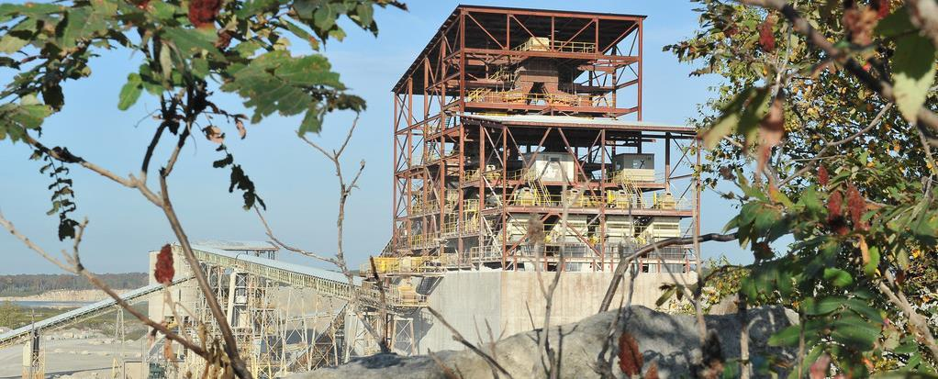
Material Size reduction Crushing, screening and impact on grinding
SPREAD 2016-2017, Settat May 2016

Slide 2
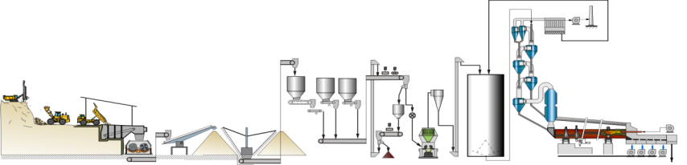
Process Overview
Material chemical homogeneity
Material size reduction…
Material moisture reduction
Material handling
2

Slide 3

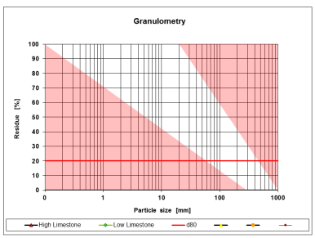
… First step, the material extraction. Generally we talk about drilling & Blasting …
Drilling &
blasting
Product size after the blasting is defined by:
Geology
Drilling & blasting procedure
Loading equipment type
Crusher type & size
3

Slide 4
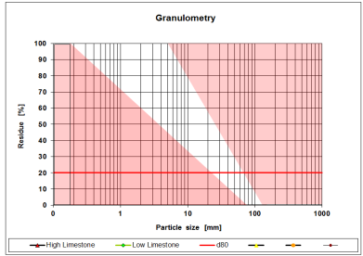
…Second step, crushing & screening…
Crushing & screening
Product size after the crushing system is defined by:
Raw mill type / size
0/30 - 50 mm for a ball mill
3% - 5% of roller mill diameter
And influenced by
Crusher feed size
Type of crushing system
4

Slide 5
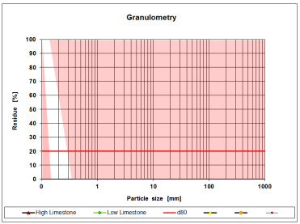
…and the last step,the raw mill system …
Grinding
Product size after the raw mill is defined by:
Raw meal burnability
5

Slide 6

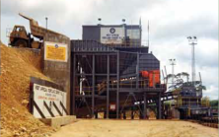
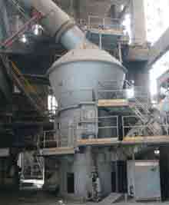
Energy Efficiency of Blasting, Crushing and Grinding vary in a large range and optimum balance in case by case based...
η %
Blasting
6

Slide 7
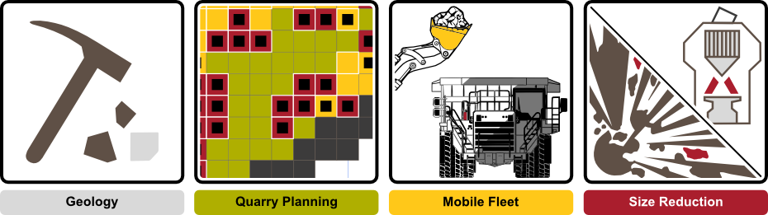

…balancing energy inputs and cost for size reduction from the blast to the kiln feed…
Optimize energy distribution blasting, crushing & grinding
Wear part management
Improve raw/cement mill
feed size
…as well as wear parts cost for crusher / raw mill …

Slide 8
A systemic approach has been grouped in four pillars aiming to secure the sustainability and efficiency of the operations from the quarry to the kiln feed…
LafargeHolcim Mining Community
… and the subsequent impact on the downstream processes…

Slide 9

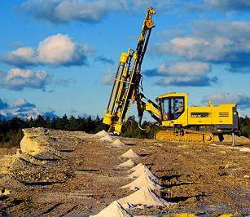
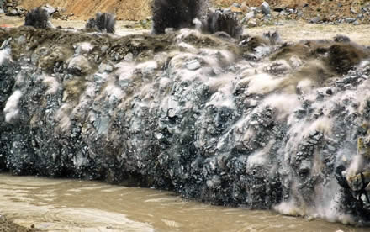
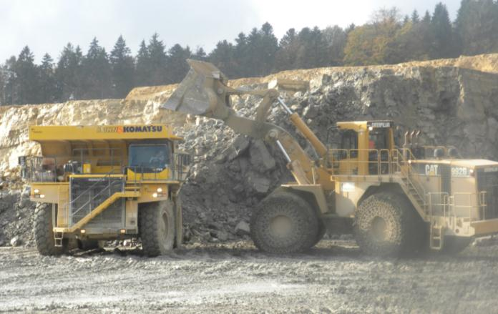

400 Mio. t/a¹⁾ of raw material are blasted, crushed and ground in order to produce raw meal for the kiln for a total spending of about 2’000 Mio. CHF/a
Raw Material Extraction
Raw Material Preparation
Raw Meal Preparation
Drilling
Blasting
Loading & Hauling
Crushing
Grinding
Current Cash Cost in Mio. CHF/a
750
350
900
1) Initial estimation excluding China, additionally, includes about 100 Miot/a waste

Slide 10

Experiences show that increasing the energy input by blasting leads to an improvement of the Crushing and Grinding processes
Blasting
Crushing
Grinding
Actual
0.2 kWh/t
2.0 kWh/t
20 kWh/t
Future
0.3 kWh/t
1.8 kWh/t
18 kWh/t
Investing more
Savings
-14 Mio. CHF/a
3 Mio. CHF/a
32 Mio. CHF/a

Slide 11
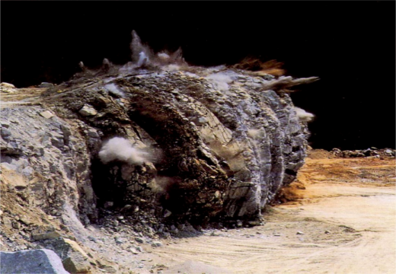
Material Size reduction – 1st Step EXTRACTION → BLASTING
11

Slide 12

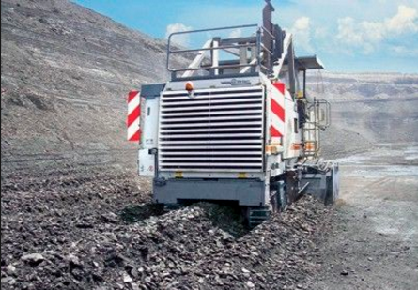
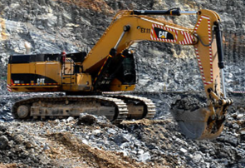
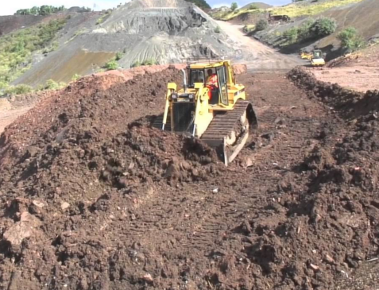
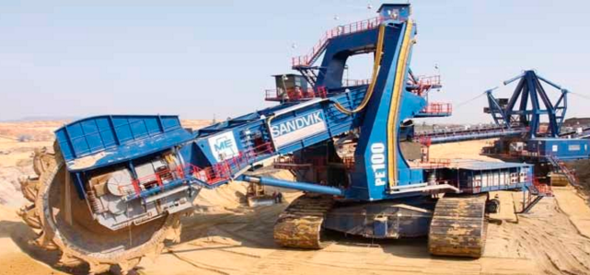
Size reduction starts in the quarry. Different raw material extraction methods are used….

Slide 13
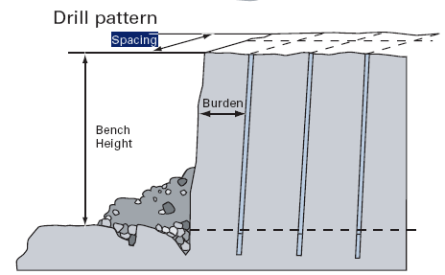
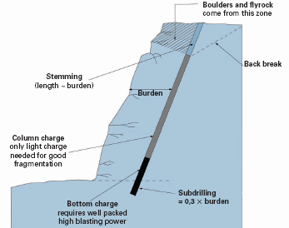
Blasting depends on many parameters…
Do you want to see a blasting?
…combined with explosive type and blast sequence
13

Slide 14
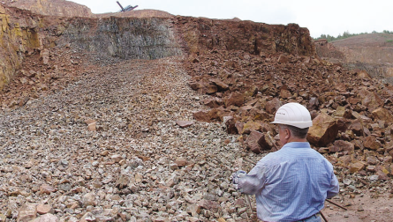
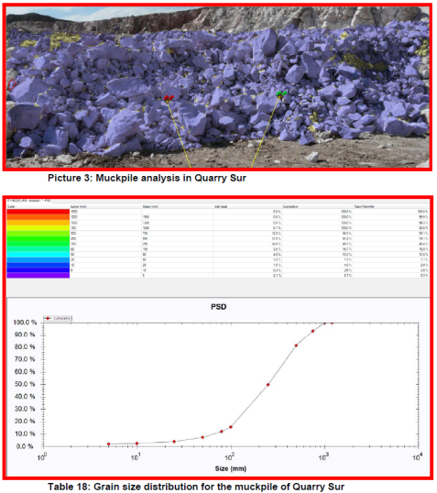
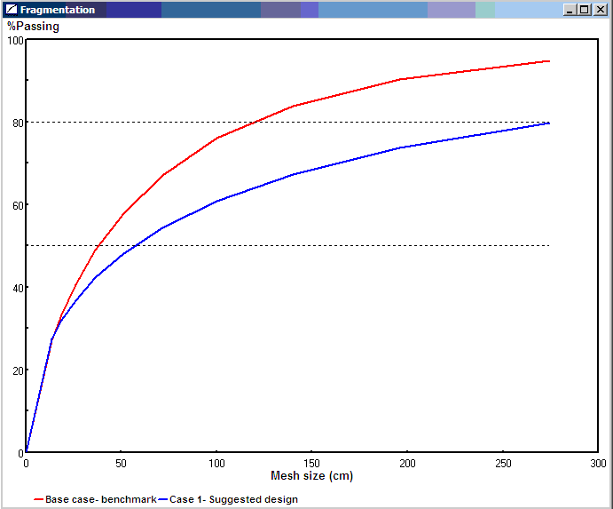
…and possibilities to improve its outcome, the fragmentation..…
Normal
Optimized
14

Slide 15
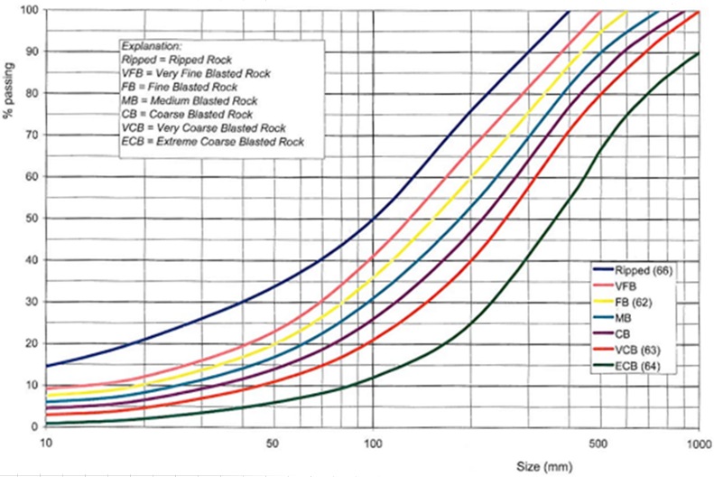
… playing a key role on influencing the performance of the 2nd size reduction step; the crushing.
The crushing feeding strategy depends mainly of the crusher physical dimensions (e.g width, roller diameter, depth, etc.)
* data according to Sandvik
15

Slide 16
Material Size reduction – 2nd Step CRUSHING

Slide 17
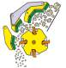

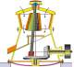
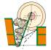
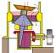
The cement crusher portfolio
Abrasiveness
> 6 months life
Wear Rates
< 6 months life
8
–
12%
>12%
>8%
<8%
Stickiness
Moisture
Moisture
<8%
>200MPa
Compressive
<200MPa
Hardness
Strength
Decision Tree for Crusher Selection
Coarse
Scalping
<150MPa
Fines
Primary
Double
Single
Hammer
Impact
Hammer
Process
Roller
Sizer
Gyratory
Jaw
Secondary
17

Slide 18
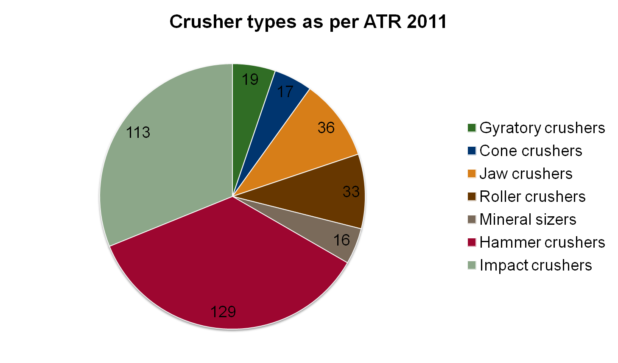
The crusher portfolio in Legacy Holcim
18

Slide 19
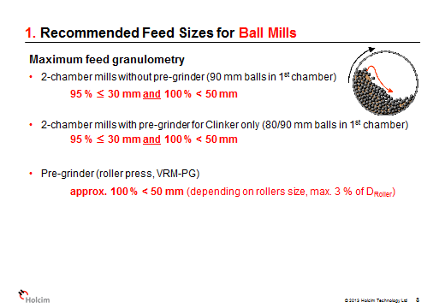
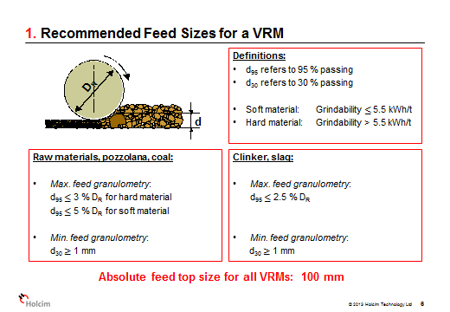
…regardless the type the crusher goal is always the same….
Crushing goal: Provide the adequate feeding in terms of size in a stable mode to the raw grinding.

Slide 20
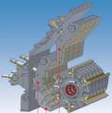

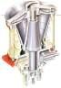

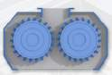

… the crusher product size is mainly impacted by the feeding (reduction ratio, RR) & the crushing settings. The stability of the product size by the crushing tools wear management ……
Impactor
Hammers
with grate
Compressive crushers
(giratory, jaw, cone)
Sizers & roller crushers
Redu. Ratio
Primary
15:1
< 50:1
< 5:1
3.5:1
4:1
Secondary
10:1
--
< 5:1
3:1
6:1
Settings Adj.
YES
YES
YES
NO
YES
The larger the reduction ratio the lower the production rate and the crusher product PSD more distorted (max size and intermediate sizes).
Adjustment of crusher settings allow to compensate the impact of wear in the crushing tools (bars, hammers, teeth) maintaining constant the crusher product PSD.
20

Slide 21
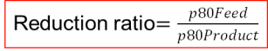
Criteria for Crusher Selection
Feed size and product size related through the Reduction ratio
Example: Feed size X: 1500 mm
Product size Y: 60 mm
Total Red. Ratio = 1500/60 = 25:1
RR_I primary crusher = 3:1
RR_II secondary crusher = 3:1
Two-stage crushing= RR1 x RR2 = 9:1
not sufficient ,3rd crushing stage required !
RR_III tertiary crusher = 3:1
Three-stage crushing= R1 x R2 x R3
> Total reduction ratio: 27:1
21

Slide 22
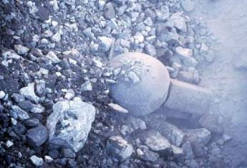
Crusher feed size definition / options
Feed size
1.131
1.4
22

Slide 23
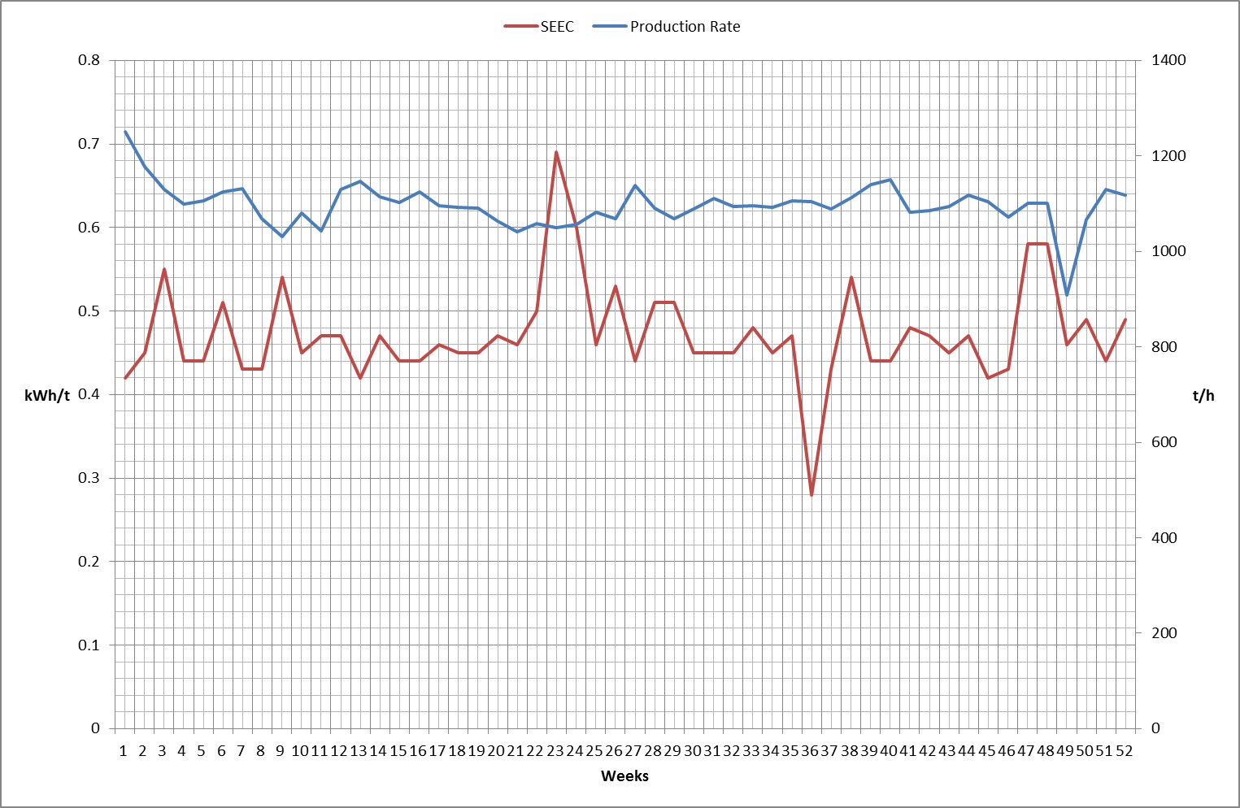
… How do you assess this crusher performance?
Luga It – Phillipines
Double Roller Crusher
Limestone
2015 Performance
Weekly Averages

Slide 24
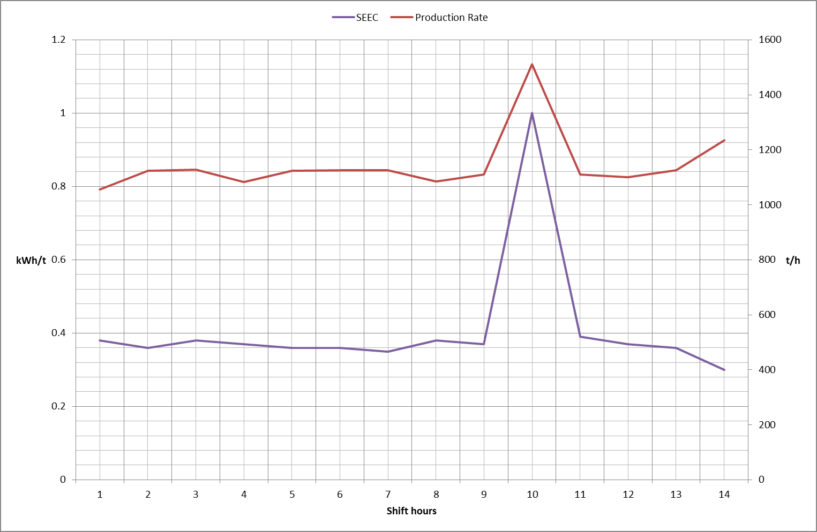
….. Would you say the same now?
Luga It – Phillipines
Double Roller Crusher
Limestone
Random shift during 2015
Hourly Averages

Slide 25
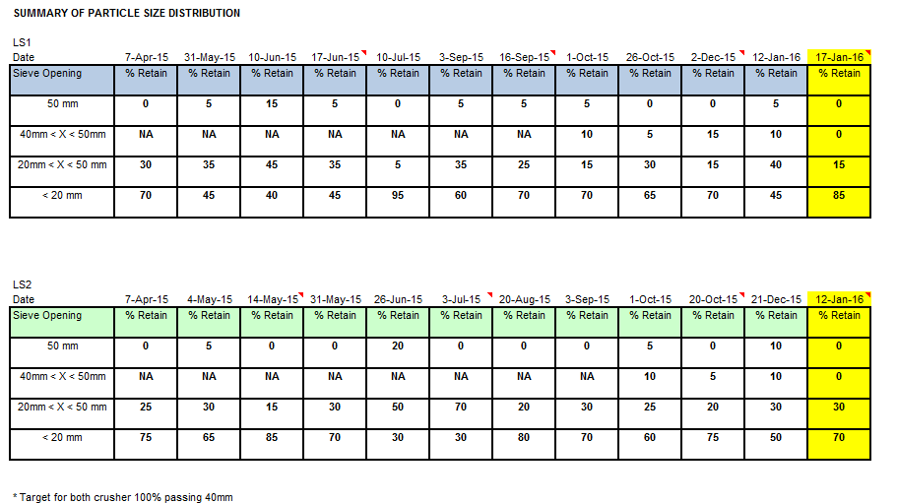
What would you say on the performance of this Crushers?
Langkawi – Malaysia

Slide 26
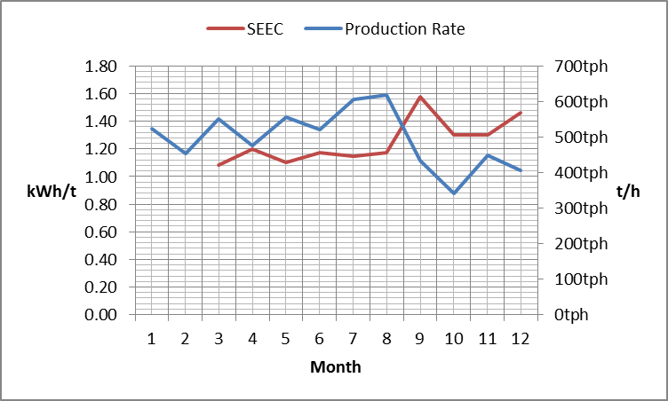
… what about adding a bit more of information?
Langkawi – Malaysia
Single Shaft Hammer
Limestone
2015 Performance
Monthly Averages

Slide 27
… but what is then a high performing crushing system, and what is influencing it?….
A crushing system is considered as high performing when produces, in a sustainable way, the desired sizes at maximum production rate at the lower cost.
Overall the performance in a crushing system is impacted by:
Material characteristics
Feed strategy (homogeneous & choke)
Operator efficiency
Crusher internals (rotor speed, rotor configuration, crushing tools shape)
Crusher settings management & crushing tools wear management
27

Slide 28
The Influence of the material characteristics
Hard material
Coarser granulation
Reduced crusher capacity
Soft material
Finer granulation
Increased crusher capacity
The type of crushed material affects crusher capacity and product PSD
Impact Crushers
28

Slide 29
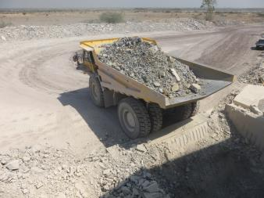
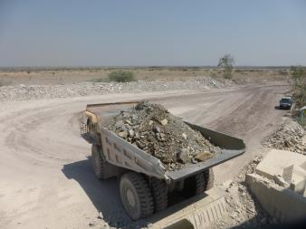
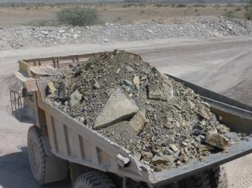
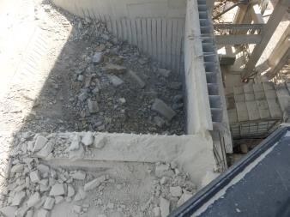
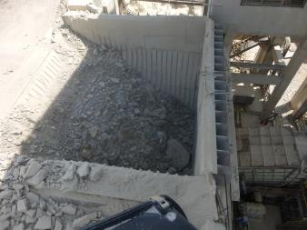
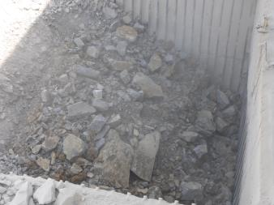
The Influence of the Feeding Strategy

Slide 30
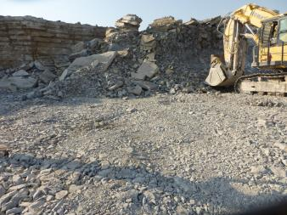
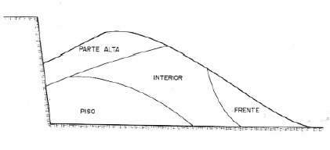
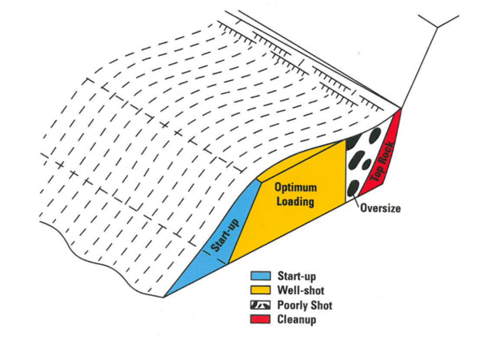
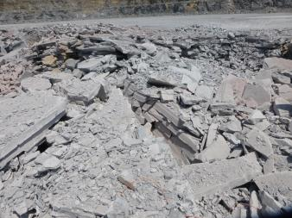
Blasting fragmentation is not exactly crusher feeding
Loading is a key process for crusher performance!!!!
Feeding strategy is not only targeting a maximum feed size is targeting an, as much as possible, homogeneous feed.

Slide 31

The adequate feeding strategy is….
Homogeneous in size distribution truck by truck with a clear defined target in maximum feed size.
Sufficient to maintain a choke feeding to the crusher
Consult the quarry colleagues
Efficient loading operators.
Blasting muckpile cut strategy (“pre-blending mode if feasible”).

Slide 32
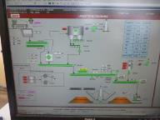

The influence of the Crusher Operator Efficiency
Process control system (Instrumentation)
Belt scales (t/h)
Counters (hours, power, amperes)
Sensors (Vibrations, bearing temperature, speed, hopper level)
Senses
Visual contact with feeding (direct or camera)
Noise of the equipment
Smell (V-Belts burning)
Information from the quarry
And, normally just counts with the possibility to change the feeder speed for increase or decrease the production rate.

Slide 33
The influence of the crusher internals. Which parameters can we control and handle to guarantee a high performing crusher?
The settings; breaking plates, grates, gaps, anvils (All crusher types but sizer which is not adjusted mechanically).
The cleaning devices (Roller crusher, Sizers).
Daily managed
Requires expert intervention (CIP) and expenditure
The crushing tools; hammers design, bars design, teeth design, teeth pattern, etc. (All types).
The material distribution onto the crushing tools; feeding geometry, chutes, feed plates; (All crusher types).
The rotating speeds ; rotors, rollers, fly wheels, etc(All crusher types).
The eccentric strokes (gyratory crushers/ jaw crushers / cone crushers).

Slide 34
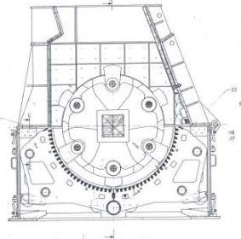

The settings management
The crusher settings defines the crushing chambers inside the crushers.
They have to be adjusted based on the product size target and the feed size.
Generally by reducing the crushing settings (gap between rollers, breaking plates, grate to hammer distance, grate slots dimensions, close side setting, etc) you can expect, assuming same feeding strategy (same size and choke)
Lower production rate.
Higher wear rate.
Finer granulometry (intermediate sieves in the curve)

Slide 35

The settings management - Impact crusher
Breaker plates
Side plates
Inlet chute
Feeding plate
Grinding path
Rotor
Bars/Hammers

Slide 36
The Impact Crusher Settings. Rules of thumb (Mix of Metso & Hazemag)
Fmax: Maximum feed size
S1~ (F_{max} + P₁₀₀*)/4 + 20 mm
S2~ S1 / 2 to 2.5
S2 > F_{max} /10
S1
S3~ S2+ 10 to 20 mm
S2
α
S4 ~ P₁₀₀ - 10 mm (Hazemag) or Using Typical Curves (Metso)
S3
If no S3 & S4; P_{max} ~ 1.6 S2
S4
* The expected Product Size targeted (e.g. 0-40 mm → P₁₀₀ = 40 mm
Coarser product in range 1mm – 10 mm with larger S1 and S2

Slide 37

The effect of the settings in PSD curves. The manufacturer Typical PSD (Metso)
37

Slide 38

The settings management, the Hammer Crusher
Single Shaft Hammer Crusher
38

Slide 39

The settings management, the Hammer Crusher
Hammers
Breaking Plates
Double Hammer Crusher
Grate Slots
Hammer to grate distance
Hammer to anvil distance (anvil and hammer wear)

Slide 40



For hammer crushers, there are various designs available, basically the size control is achieved through the opening of the outlet grate
Replacement of outlet grate (shift in / out) only option for product max size control.
Some models have an adjustable grate to compensate wear of the hammer heads (Rule of Thumb -> Distance = 90% Grate slot width). Increase of distance reduce production rate increasing wear.
40

Slide 41


The grate is key for the max product size, the breaking plate for the granulation
6 cm
30,5 cm
10 cm
9 cm
8,5 cm
3 cm
The breaking plate distance to hammer provides the possibility to have an overall finer product granulation or coarser. Production rate is thus, affected.

Slide 42


The effect of the settings in PSD curves. The manufacturer Typical PSD (FLS EV hammer crusher family & ThyssenKrupp)
42

Slide 43


The settings management; compressive crushers
Only as primary stage
Product with little fines
CSS/OSS adjustments range depends on machine size
Secondary stage made with a cone crusher of hammer crusher
Crushing chambers always as full as possible to avoid fishy product and allow maximum utilization of liners
200 – 900 t/h
600 – 8’000 t/h
Pmax= 1.3 – 2.5x CSS
Pmax= ~ 2 x OSS
Product: 80%P_{CSS}
Product: Target = OSS
43

Slide 44

The setting management; the gyratory crusher
For hard abrasive rock
Does not require a feed hopper
Can be choke fed from two sides
Largest acceptable feed = Feed opening x 0.9
Feed in direction of spider arms for material distribution
42
65
Feed
Opening
Nomenclature example: 42-65
- 42’’ feed opening
- 65’’ largest shaft diameter
44

Slide 45

Gyratory crusher settings
With hydroset
With screw
45

Slide 46

The effect of the settings in PSD curves. The manufacturer Typical PSD (Metso)

Slide 47


Cone crusher types
Cone
For secondary / tertiary applications
Two types
Hydrocone
Basically a small gyratory crusher
Symons type
Different movement & setting
47

Slide 48

Symons type cone crusher
Cone
48

Slide 49
Typical design of a cone crusher, example for HP crusher type from Metso
50 – 800 t/h
Pmax= 1.3 – 2.5x CSS
CSS
Product: 80%P_{CSS}
49

Slide 50

The effect of the settings in PSD curves. The manufacturer Typical PSD (Metso)

Slide 51

The setting management; Double roller crusher
51

Slide 52

The setting management; Double roller crusher
Pmax= 1.2 – 1.3 x Gap
Product: 80%P_{gap}

Slide 53

The effect of the settings in PSD curves. The manufacturer Typical PSD (Sandvik)

Slide 54


Roller crusher production rate versus dimensions, example for FLS machines
54

Slide 55

The setting Management – The mineral sizer
Settings are defined from manufacturing. Crushing tools wear management is the key to keep both production rate and product size.
55

Slide 56

What else can be done to increase the production rate or influence the product granulometry? Impact Crusher
Rotor speed can be adjusted but always > 20 m/s (referred to the number of blow bars).
Recommended speed in the range of 30-36 m/s (StDC)
Higher speed are feasible but after consultation with CIP.
Slotted Rotor → Special configuration. Never without consulting CIP
Flatter inlet chute = coarser product. e.g α from 60° to 40°➔ 35%P_{1mm} to 20 %P_{1mm}
Feed even along the rotor width → uneven wear impacting the production rate and the wear costs.
Choke feeding → underfeed leads to uneven wear, low production rate and distorted granulometry.
Fine feed
Coarse feed

Slide 57

What else can be done to increase the production rate or influence the product granulometry? Hammer Crusher
Recommended speed in the range of 30-36 m/s (StDC)
Higher speed are feasible but after consultation with CIP.
Feed even along the rotor width → uneven wear impacting the production rate and the wear costs.
Choke feeding → underfeed leads to uneven wear, low production rate and distorted granulometry.
Progressive grate design when clogging effect in the grate occurs – Higher stickness of the material.
Segmented grates for quick exchange.

Slide 58
What else can be done to increase the production rate or influence the product granulometry? Gyratory Crusher
Rotational speed is given and to challenge it a significant change in the material characteristics is expected. Consultation with CIP
Choke feeding → underfeed leads to uneven wear, low production rate and distorted granulometry
Increasing the eccentricity → Bigger stroke lead for more production rate. Consultation with the CIP

Slide 59

What else can be done to increase the production rate or influence the product granulometry? Hydrocone & Symons Crusher
Rotational speed is given and to challenge it a significant change in the material characteristics is expected. Consultation with CIP
Choke feeding → underfeed leads to uneven wear, low production rate and distorted granulometry
Increasing the eccentricity → Bigger stroke lead for more production rate, better product shape.
The interchangeable crushing cavities are the most common way to adapt the crusher to new feed conditions or new product sizes requirements. Expenditure is associated and normally is never done. Consultation with CIP is a must.

Slide 60


What else can be done to increase the production rate or influence the product granulometry? Double Roller Crusher
The cleaning scrapers guarantees higher production rate as maintains the rollers gap by removing buildups from the inter teeth channel
Feed even along the rotor width → uneven wear impacting the production rate and the wear costs.
Choke feeding → underfeed leads to uneven wear, low production rate and distorted granulometry.
Recommended speed in the range of 5-7 m/s (StDC)
Possibility to reduce one roller speed to increase shearing effect → gaining production rate in cases of high stickiness of the material

Slide 61





What else can be done to increase the production rate or influence the product granulometry? Mineral Sizer
The cleaning scrapers guarantees higher production rate as maintains the rollers gap by removing buildups from the inter teeth channel
Teeth pattern → e.g. 4 x 6 to 3 x 8 for scroll pattern. Granulometry is expected also coarser
Different teeth height → Grabbing oversized
Addition of a breaker anvil
Timing of the rollers when scroll teeth pattern
Recommended speed in the range of 2-3 m/s (StDC)
Higher/lower speed are feasible but after consultation with CIP. Expensive with Spur Gears

Slide 62
Assessing a crusher system

Slide 63

Generally, crushing is performing far below nominal capacity and affect the performance of the raw mill but as well as the one of the quarry operation.
Blockages due to oversized feed
Crusher plugging due to material stickiness
Low transport capacity of conveying system after crusher (e.g. SH, DV, MG, etc.)
Variations of rock hardness (UCS)
Low capacity of mobile fleet
Wear of crushing tools lead to loss of product size
63

Slide 64
Crusher system assessment scope
The crusher assessment shall answer questions like:
Why the production rate is lower than BDP? Can I increase it?
Can I reduce the it energy consumption of the system?
Is the product homogeneous and in target? Can I improve any condition?
Is the wear cost optimize? Can I reduce it?
In the feeding Is the production rate the maximum to achieve?
The scope of the assessment must cover two main streams; Operational and Production which often cross among them.
Operational
Operating hours
Production Rate (BDP)
Workflow procedure
System Availability
Downtime & Idle Time
Production
Production Volumes
Energy Consumption
Crusher Product Size
Wear

Slide 65

Define the boundaries of your assessment
Upstream process
Crusher
Downstream process
System Limits
Source: Garadagh Crushing System

Slide 66




Set a base line → Start to formulate questions
Recommended a year, monthly average.

Slide 67


Set a base line → Analyze the crusher setting and target working conditions, compare to the design → Keep asking questions
What are the reasons for a change on Maximum Feed Size?
What are the reasons for a change on rotor speed?
What current setting strategy is based on?
When were set the current BDPs?
How long since adjustments for the inspection?

Slide 68



Field observation under regular operational conditions → Sit on the Crusher CCR for a day, observe and record → Keep asking questions
Analyze the feeding.
Is granulometrically homogeneous? → All dumps look similar in hopper
Is continuous?
Try to estimate PSD of the feeding → Picture PSD Analysis (Visiorock, Wipfrag, Split Engineering) in hopper and blasting muckpile for comparison.
Observation
68

Slide 69

Field observation under regular operational conditions → Sit on the Crusher CCR for a day, observe and record →Keep asking questions
Analyze the effectiveness of the PID control loops if there are.
Observe the Operator routines for crushing monitoring and control.
How is the communication between crushing, quarry, CCR or Pre-Blending?
Record operational data: Crusher throughput, absorbed power, downtime and its causes, idle time and its causes.
Calculate & Compare:
Observation
Specific energy consumption
Gross Production rate
Net Production rate
Availability
Effectiveness (OEE)
69

Slide 70

Take samples under regular operational conditions
Material Sampling for:
Product size analysis.
Reduction Ratio Analysis
Screens efficiency analysis.
* Make sure the crusher settings status is known to be able to link the results to them
70

Slide 71

When Sampling….. remember
Sampling from belt conveyor after a system crash stop
Sample size must be adapted to maximum grain size in order to be representative
71

Slide 72


Gross Production rate vs Net Production Rate (Utilization factor)
$$Gross Production Rate=\frac{Production [t]}{Operating hours [h]}$$
Crusher running with & without feeding (Crusher hour meter)
Crusher running with feeding (feeder hour meter)
$$Net Production Rate=\frac{Production [t]}{Feeding hours [h]}$$
$Gross Production Rate x Utilization Factor =$ Net Production Rate
$Utilization Factor [\%]=\frac{Crusher running \& fed [h]}{Crusher Operating hours [h]}$ x 100

Slide 73





Crusher visual inspection
Do you see anything that explains/answers the questions done before?
*The inspection should be done close in time to the field observation.
General wear observation
Impact plates position. Measure
Grinding path position measure
Feeding plate, braking plates, rotor ribs
73

Slide 74
Crusher system assessment results
After measurements, inspection, monitoring and investigation we are able to answer our questions:
Why the production rate is lower than BDP? Can I increase it?
Can I reduce the it energy consumption of the system?
Is the product homogeneous and in target? Can I improve any condition?
Is the wear cost optimize? Can I reduce it?
In the feeding Is the production rate the maximum to achieve?
An prepare a action plan to correct or improve whatever finding:
Setting adjustment calendar (To increase the product size homogeneity)
Reduce maximum feed size (To increase the production rate)
Adjustment of the control loops (To reduce lack of feeding in crusher)
Or set trials for new product size target (finer).

Slide 75
Size Reduction Initiative

Slide 76
A Global Initiative is a program of projects that aims to improve performance/cost by addressing common challenges identified through benchmarks and analysis and lead to finally sustainable and continuous improvement within the daily operations.
Mine to Kiln (M2K)
SRi
Mining Performance Booster
Initiative n-1
Initiative n
Data source* to analyze potentials of a plant / a region
KPI’s* to analyze current data, but also track progress of implementation
Tools* / templates* to: calculate potential of initiative, track progress of implementation, reporting
Establish a clear process with roles and responsibilities
Training*
Others*
* … exists or have to be developed

Slide 77
…balancing energy inputs and cost for size reduction from the blast to the kiln feed…
Optimize energy distribution blasting, crushing & grinding
Wear part management
Improve raw/cement mill
feed size
…as well as wear parts cost for crusher / raw mill …

Slide 78










…. because a better performance in the raw mill affects the upstream processes …
Raw Mill Assessment
Crushing Assessment
MF Site Assessment
Drill & Blast Assessment

Slide 79

Coordination - cooperation mines / production – process / maintenance is a key parameter for capturing identified benefits
Benefits for all involved
Capturing benefits is the drill / blast / load / haul operations
Improved specific energy consumption of crushing
Improved efficiency of the raw mill (electrical consumption)
Improved reliability of the raw mill (higher MTBF, lower probability of gearbox failure by vertical roller mill)

Slide 80




Impact of feed size on raw mill performance is a fact
There are much more experiences:
Mabini
Wadi
Malagueño
Tecoman
Ternate
DS → 1.2 kWh/t
LN → 0.9 kWh/t
GU → 1 kWh/t
HN → 2.2 kWh/t
80

Slide 81


More recently….
Kantaan April 2016
Luga It January 2016

Slide 82

…Techport study along 2015, after the SRi Workshop at Wadi shows estimated benefits in the range of 930 kCHF/a for the identified focus plants …
Pilot SRi Workshop 2015 / 410 kCHF (+)
2018, new quarry
2017, new quarry
2017, new fleet
SRi Workshop 2016
2017
…for the 1st large scale project for the SRi…

Slide 83

The developed simulator allows better definition of the business cases with the aim to foster the feed size optimization to the raw mills
Foster own plant initiatives as OZ, MG, CG, HR
Link also cement mills (GU, NO): e.g. N1&2 + 21% production rate as per LST feed size optimization
Foster utilization of alternative suppliers (e.g. Vega) to CIP and higher technology wear parts (e.g. Martensitic steels, ceramic inserts)
DMI WS at Wadi done for spreading the initiative to India

Slide 84
…now that we did the crusher assessment we can estimate impact of change of feed size in the raw mill…
The model is based on a simple and demonstrated fact “The decrease of specific energy consumption in the mill motor is linked to the increase of specific energy consumption in the crusher upstream”.
Exactly the new Mill SEEC will be the Existing minus the increase of Crushing specific energy consumption times a Bonus Factor
The bonus factor calculation is based in demonstrated cases.
So… by estimating the new crushing energy consumption when reducing the product size we will be able to estimate mill motor and system new energy consumptions and also crusher system energy consumption.
$$Mill SEEC 2=Mill SEEC 1 −BF x (Δ Crusher SEEC)$$

Slide 85
…… let’s do an example with an impact crusher
Current Crusher Settings:
P90% = 80 mm
Target Crusher Settings
P90% = 50 mm
$$Mill SEEC 2=Mill SEEC 1 −BF x (Δ Crusher SEEC)$$
85

Slide 86
Impact of feed size on raw mill performance
86

Slide 87
According to Metso crusher specific energy consumption increases drastically with end product sizes
Influence of crusher setting (IC) on kWh/t for the crusher
1.1 kWh/t
0.87 kWh/t
87

Slide 88
Basics on Screening
Technical Development Program for PPE 2015-2016

Slide 89

Operating Principle and Design Features
Terminology of Separation Process
(note that different words are used for the same)
Fines (F)
Fine Fraction
Product
Screen
Feed (A)
Incoming Flow
Rejects(R)
Coarse Fraction
Tailings
89

Slide 90


Principle of screening
Deck length defines quality
Deck width defines capacity
Factors affecting stratification
Material characteristics
Bed height
Slope
Stroke characteristics
90

Slide 91





Screening equipment
Motion: Linear or circular
Single or multiple decks (to produce various fractions)
Wobbler screens for sticky material
91

Slide 92

Application in open circuit crushing system
Scalping: removal of fines before crushing
92

Slide 93

Application in closed circuit crushing system
Control of top grain size
93

Slide 94



Screen performance & efficiency
Factors affecting screen performance & efficiency
Feed material
Motion type
Feed rate
Feed point (material distribution on deck)
Screen size
Screening media
Screen inclination
Opening shape
Stroke
Frequency
94

Slide 95

Screening Efficiency & Quality
Coarse material in fine fraction
Due to wear or holes
Due to fishy particle shape
Fine material in coarse fraction
Due to clogged screen
Due to low efficiency
Due to screen saturation
→ Goal: < 20 % fines in coarse
95

